Slide 1
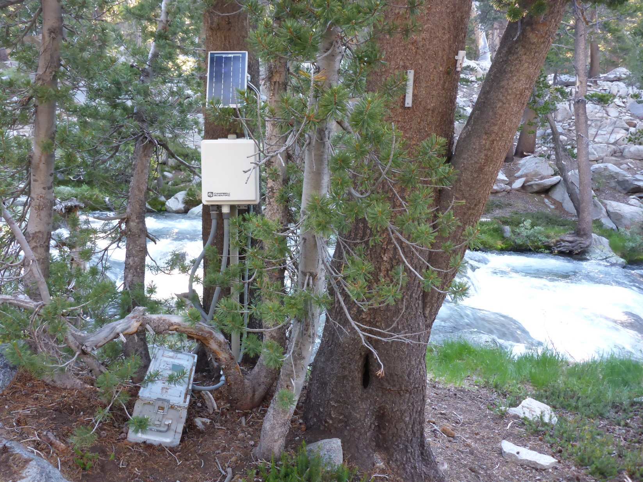
Lyell Fk. Tuolumne River
Below Maclure Cr. Stream Gage
Latitude: 37.777 Longitude: -119.261 Datum: NAD83
Elevation: 9650
(Updated 7/6/2015)

Slide 2
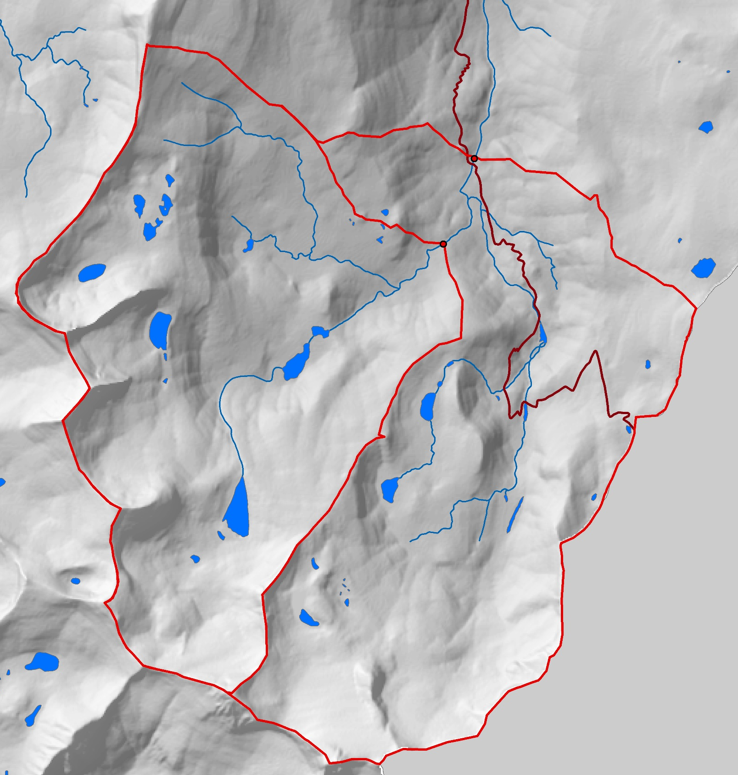
Lyell Fk. below
Maclure Cr
Maclure
Creek
JMT/PCT

Slide 3
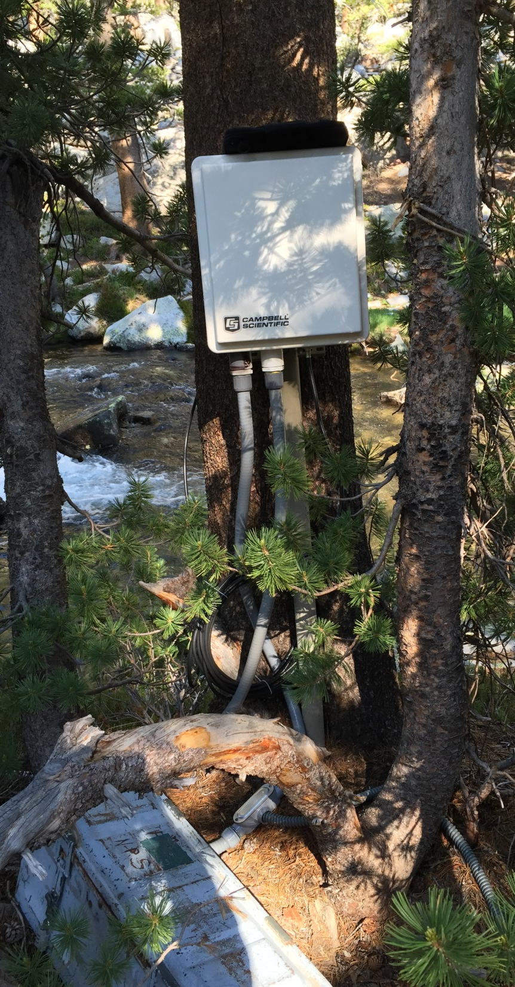
Site Inventory: 6/24/2015
CR1000 Datalogger SN:7519 HIF # 130889-Stock #5203013
CS450-L P.T. SN:70010535 25ft cable
CS547A-L Sp. Cond. SN:6181 30’ cable Kc:1.411
A547 Interface
7Ahr. Battery with “nested” solar controller
External ammo can:
55 Ahr. 12V Battery
Ammo box needs another lock.(7/7/2015)
Conduit connections to box: 1”
Conduit connection to Alpine Gage P.T. mount: ¾”

Slide 4
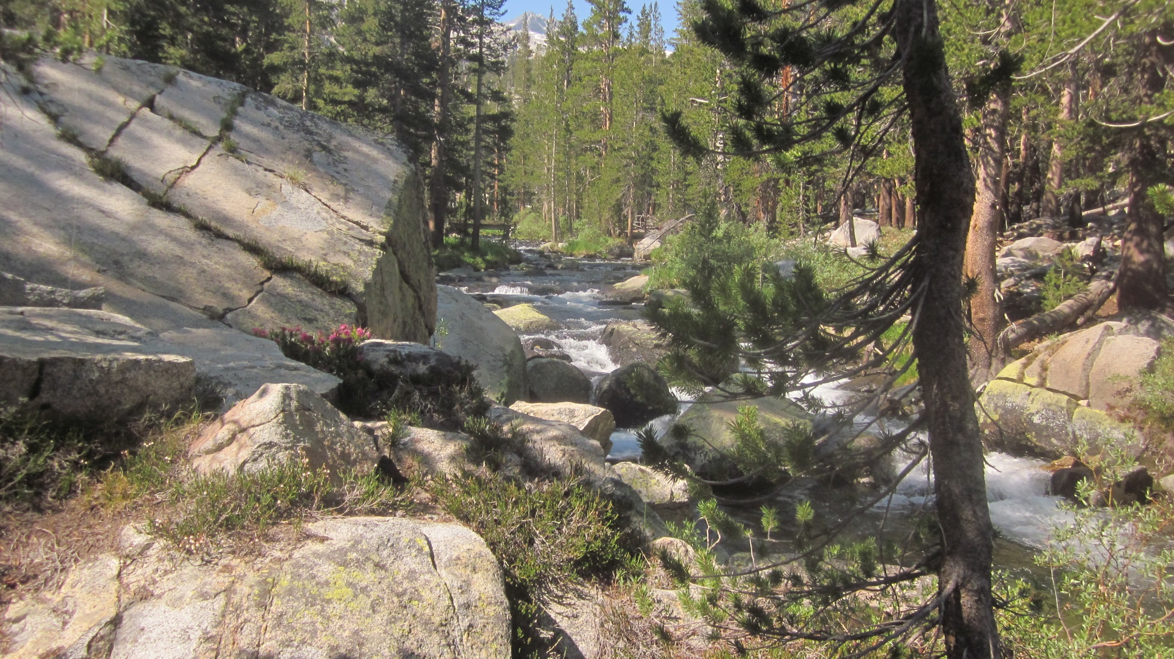
Looking upstream from stream gage at PCT/JMT footbridge
PCT/JMT footbridge

Slide 5
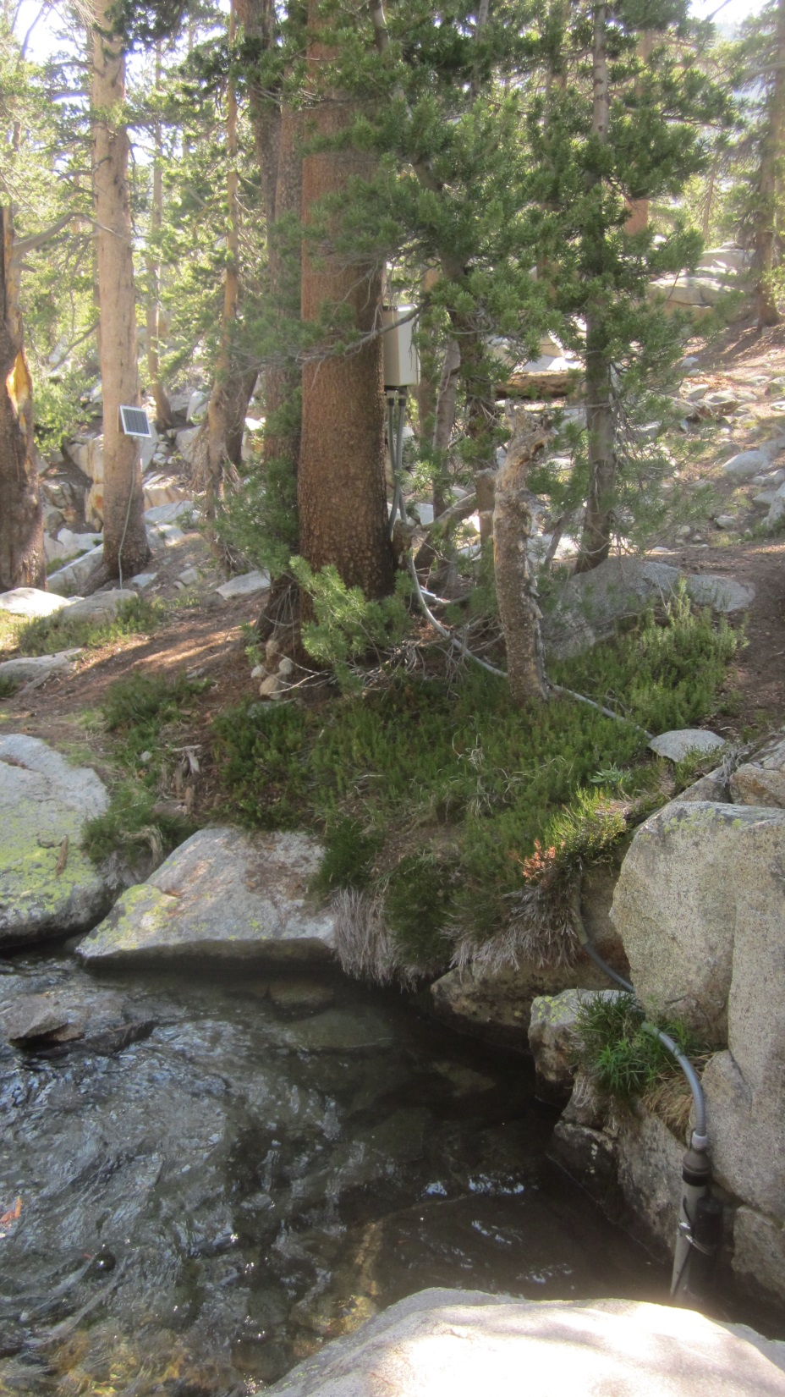
Current Datalogger Program:
Attached under 6/24/2015 Field visit hydrometeric notes in Aquarius.
Data logger enclosure
New solar panel
Installed in 2017:
Relocated to Datalogger
tree
New Tape
Down datum
New Vented P.T.
“Alpine Gage”
Solinst stilling
tube
Photo: 6/23/2015

Slide 6
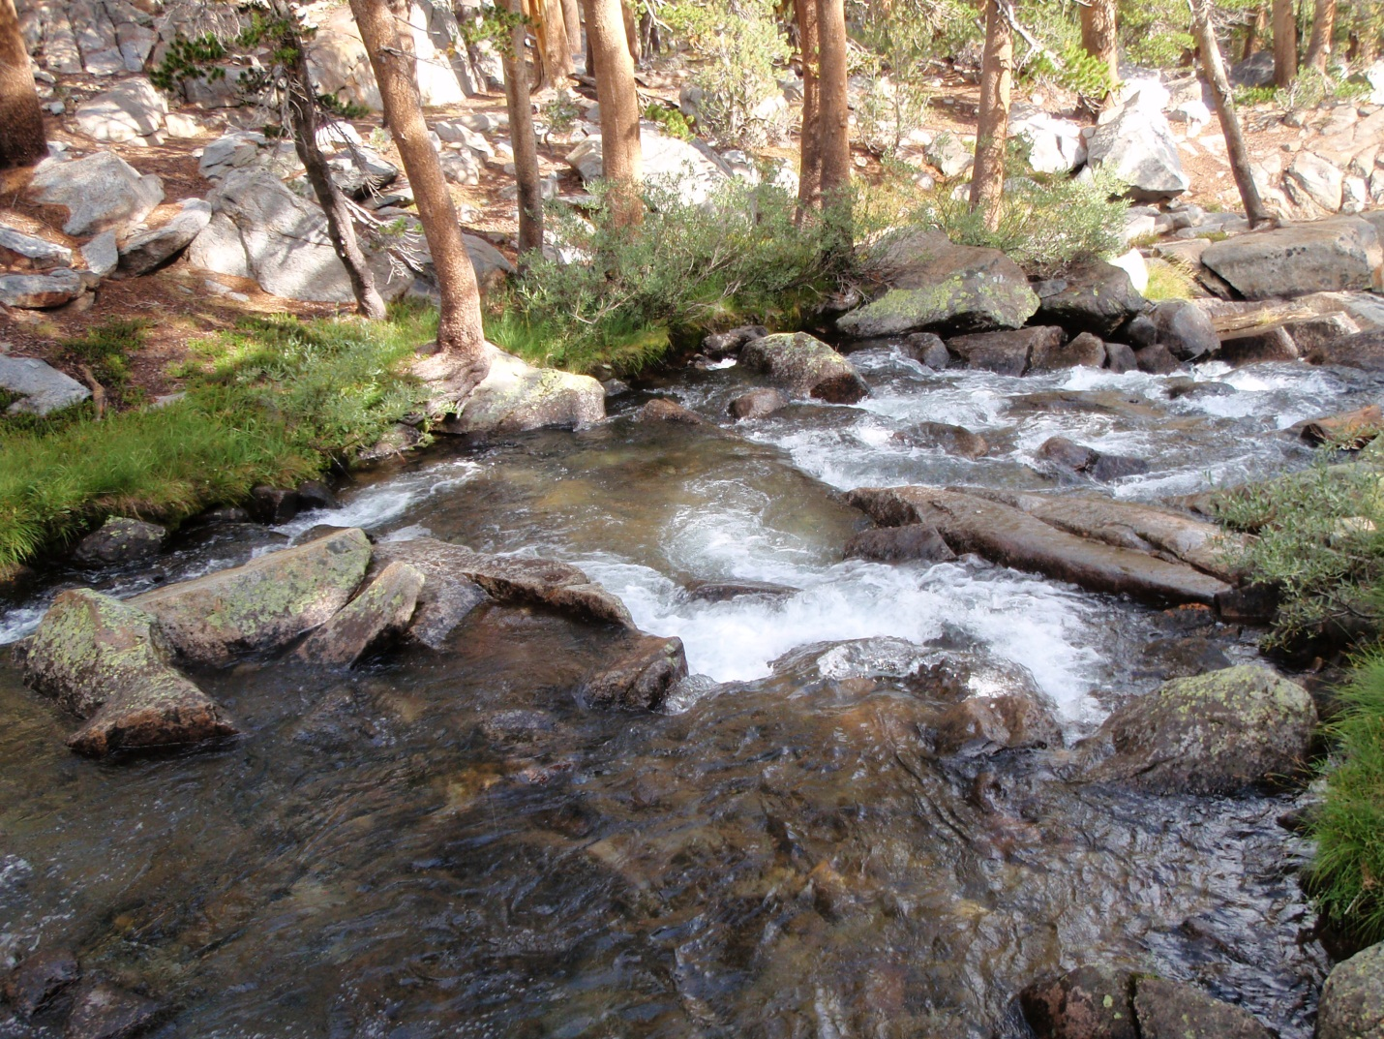
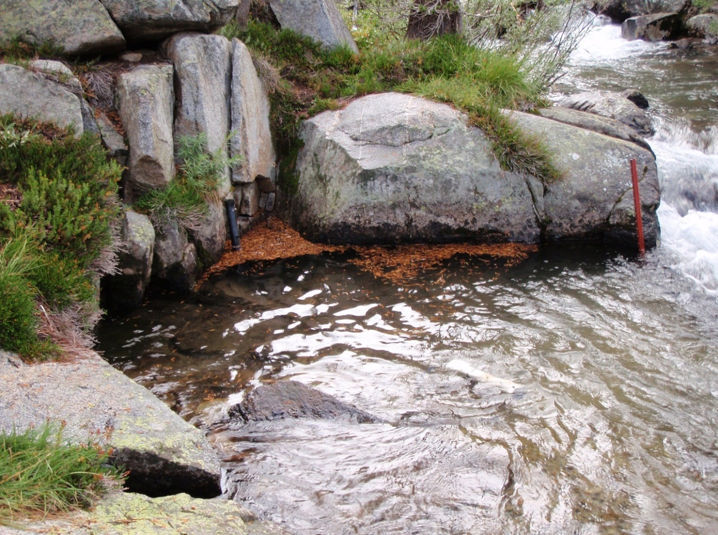
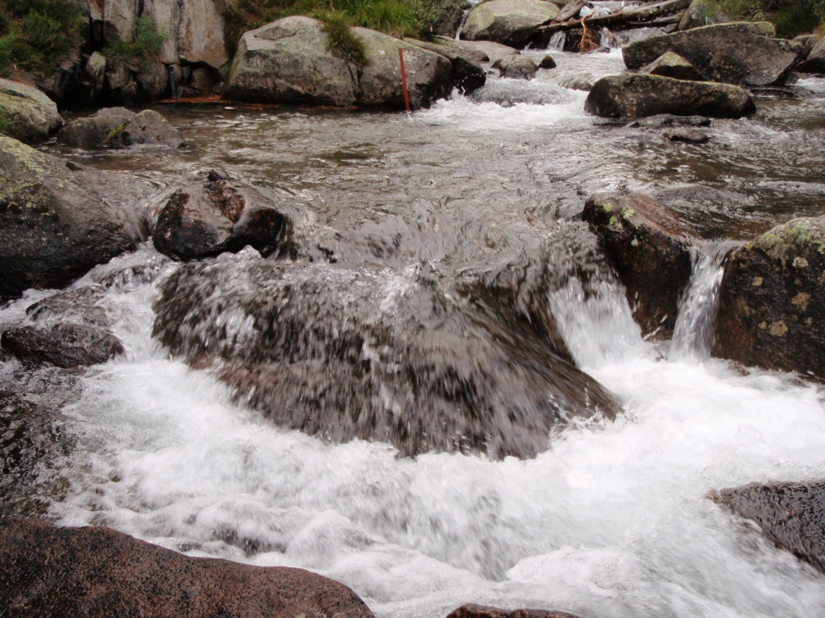
Need enter
PZO
Section
Control
Gage Pool

Slide 7
6/24/2015 Level Survey Notes
Location | Benchmark manufacturer #s on stainless bolt heads | Time | Actual Survey Rod measurements (ft.) | Relative Elevations (ft) with making BM1=100.0'
BM1 Top | F593C CK | 10:07 | 3.875 | 100
TD Bolt Middle X | ABP F593 C (w/X cut into for TD measurement) | 10:07 | 4.12 | 99.755
BM2 Top | ABP S30400 | 10:07 | 4.266 | 99.609
BM2 -ABP S30400 (likely buried under duff)
TD Bolt –
w/ ”X”
ABP F593
BM2 –
ABP S30400
(out of view in
Photo)
Photo: 6/23/2015

Slide 8
8/14/2018 Level Survey Notes
Location | Benchmark manufacturer #s on stainless bolt heads | Actual Survey Rod measurements (ft.) | Relative Elevations (ft) with making BM1=100.0' | Difference from 2015
BM1 Top | F593C CK | 5.67 | 100 | 0.00
TD Bolt Top | ABP F593 C (w/X cut into for TD measurement) | 5.9 | 99.77
TD Bolt Middle X | ABP F593 C (w/X cut into for TD measurement) | 5.92 | 99.75 | 0.00
BM2 Top | ABPS S30400 | 6.06 | 99.61 | 0.00
BM2 -ABP S30400 (likely buried under duff)
TD Bolt –
w/ ”X”
ABP F593
BM2 –
ABP S30400
(out of view in
Photo)
Photo: 6/23/2015

Slide 9
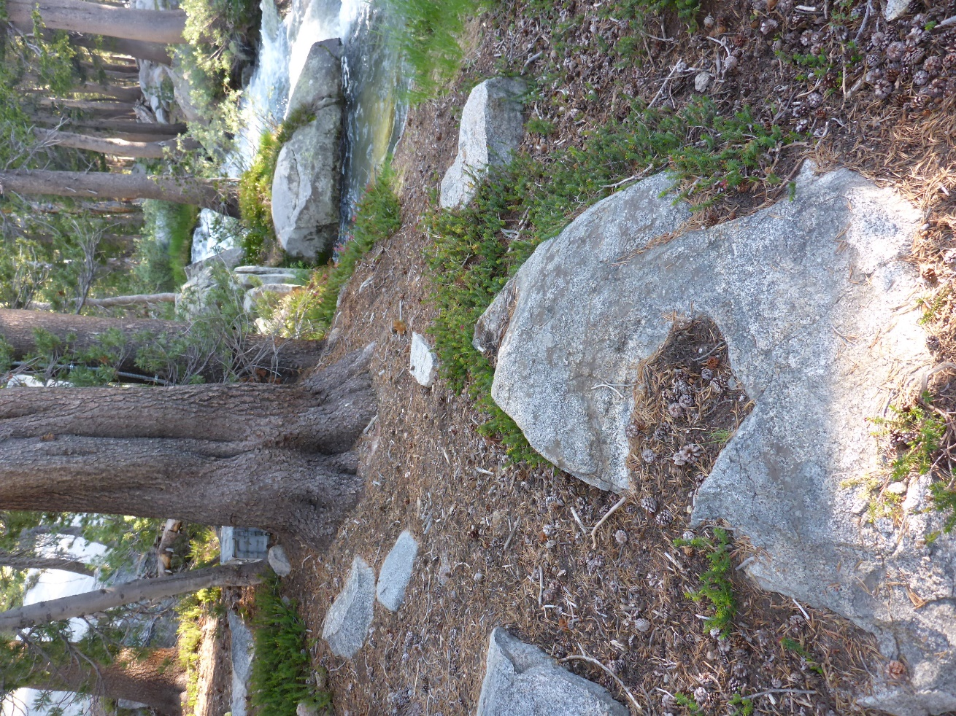
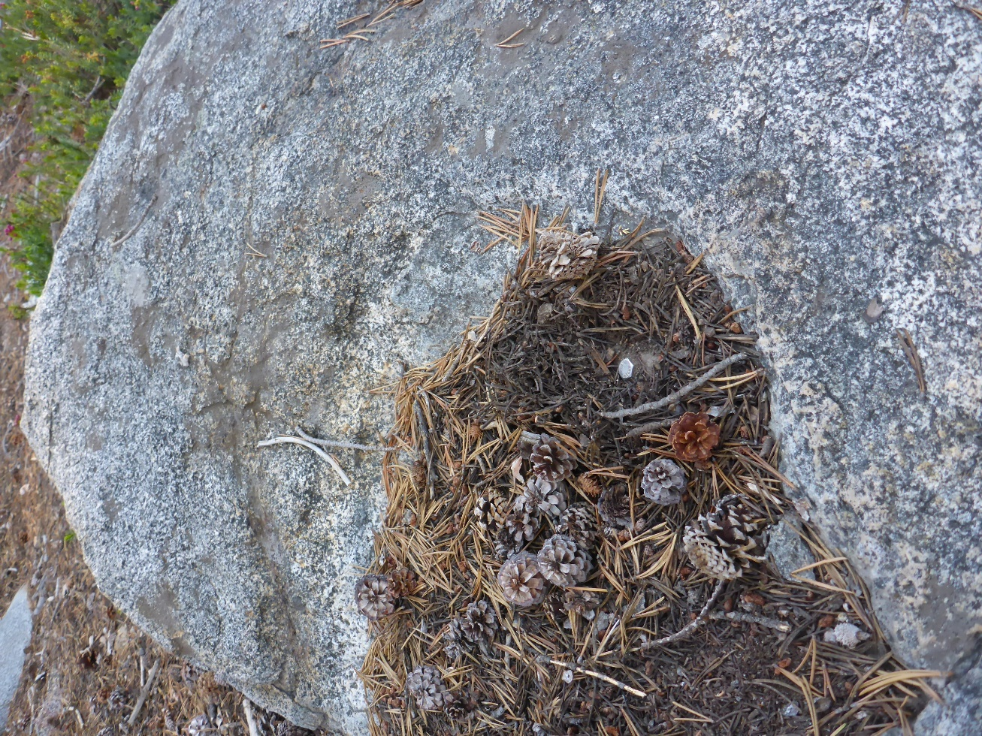
Benchmark Bolt
BM2 -ABP S30400

Slide 10
6/23/2015 Datum-change level survey notes
Location | Time | Actual Survey Rod measurements (ft.) | Relative Elevations (ft) with making BM1=100.0'
BM1 Top | 10:30 | 7.475 | 100
TD Post Top | 10:30 | 8.402 | 99.073
TD Bolt Middle X | 10:30 | 7.72 | 99.755
TD Post Top –TD Bolt Middle X Elevation Diff |  |  | -0.682
New TD Bolt
Datum, installed
6/24/2015
Old TD Post Datum,
installed:
9/25/2006
removed: 6/24/2015
Gage Pool
Photo: 8/21/2013

Slide 11
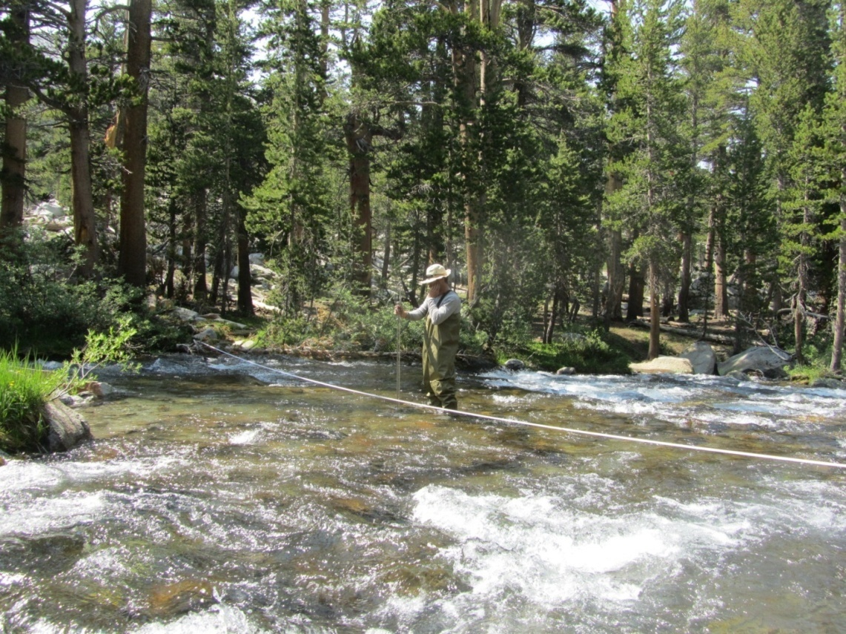
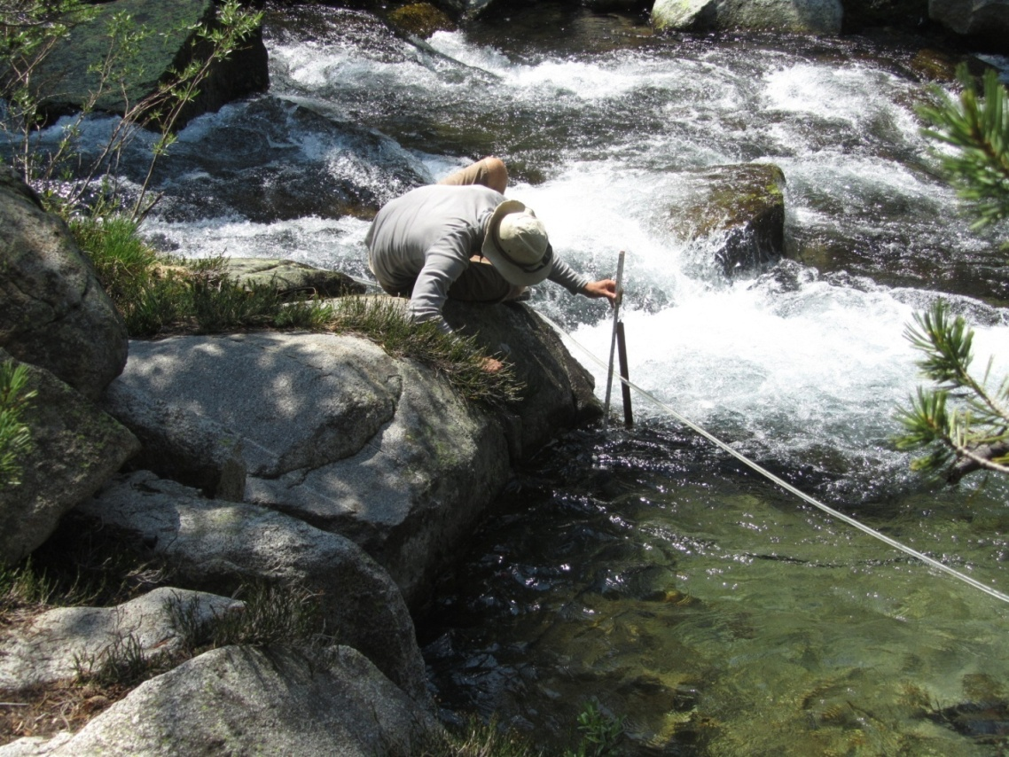
Early (2006-2011) stream gaging activities were poorly documented.
What is this discharge measurement referenced to?
How is this recorded?
Photos: 7/2011

Slide 12
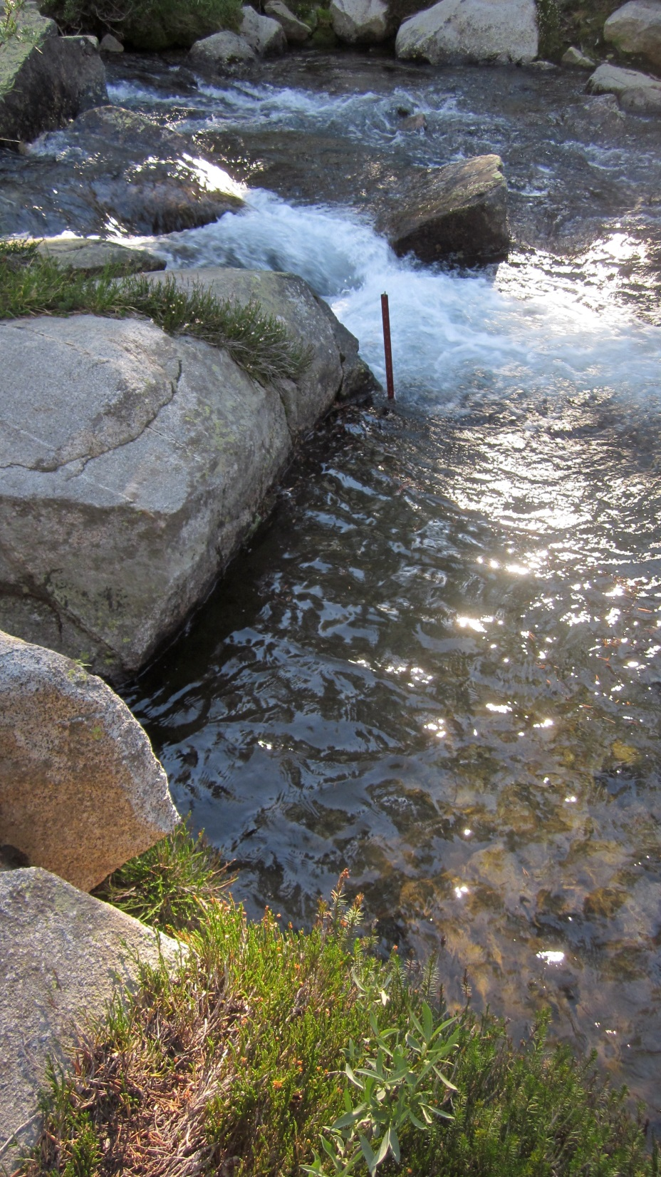
Also used as the Datum from 2010 - 6/23/2015. Gage height = 10 – (TD from post to water surface)
Old T-post “Staff Plate”
with sharpie lines, read as
a staff plate.
Solinst stilling
Tube (out of view)
Old vented P.T. mount,
Removed 6/23/2015,
(hard to see)
Photo: 7/24/2012

Slide 13
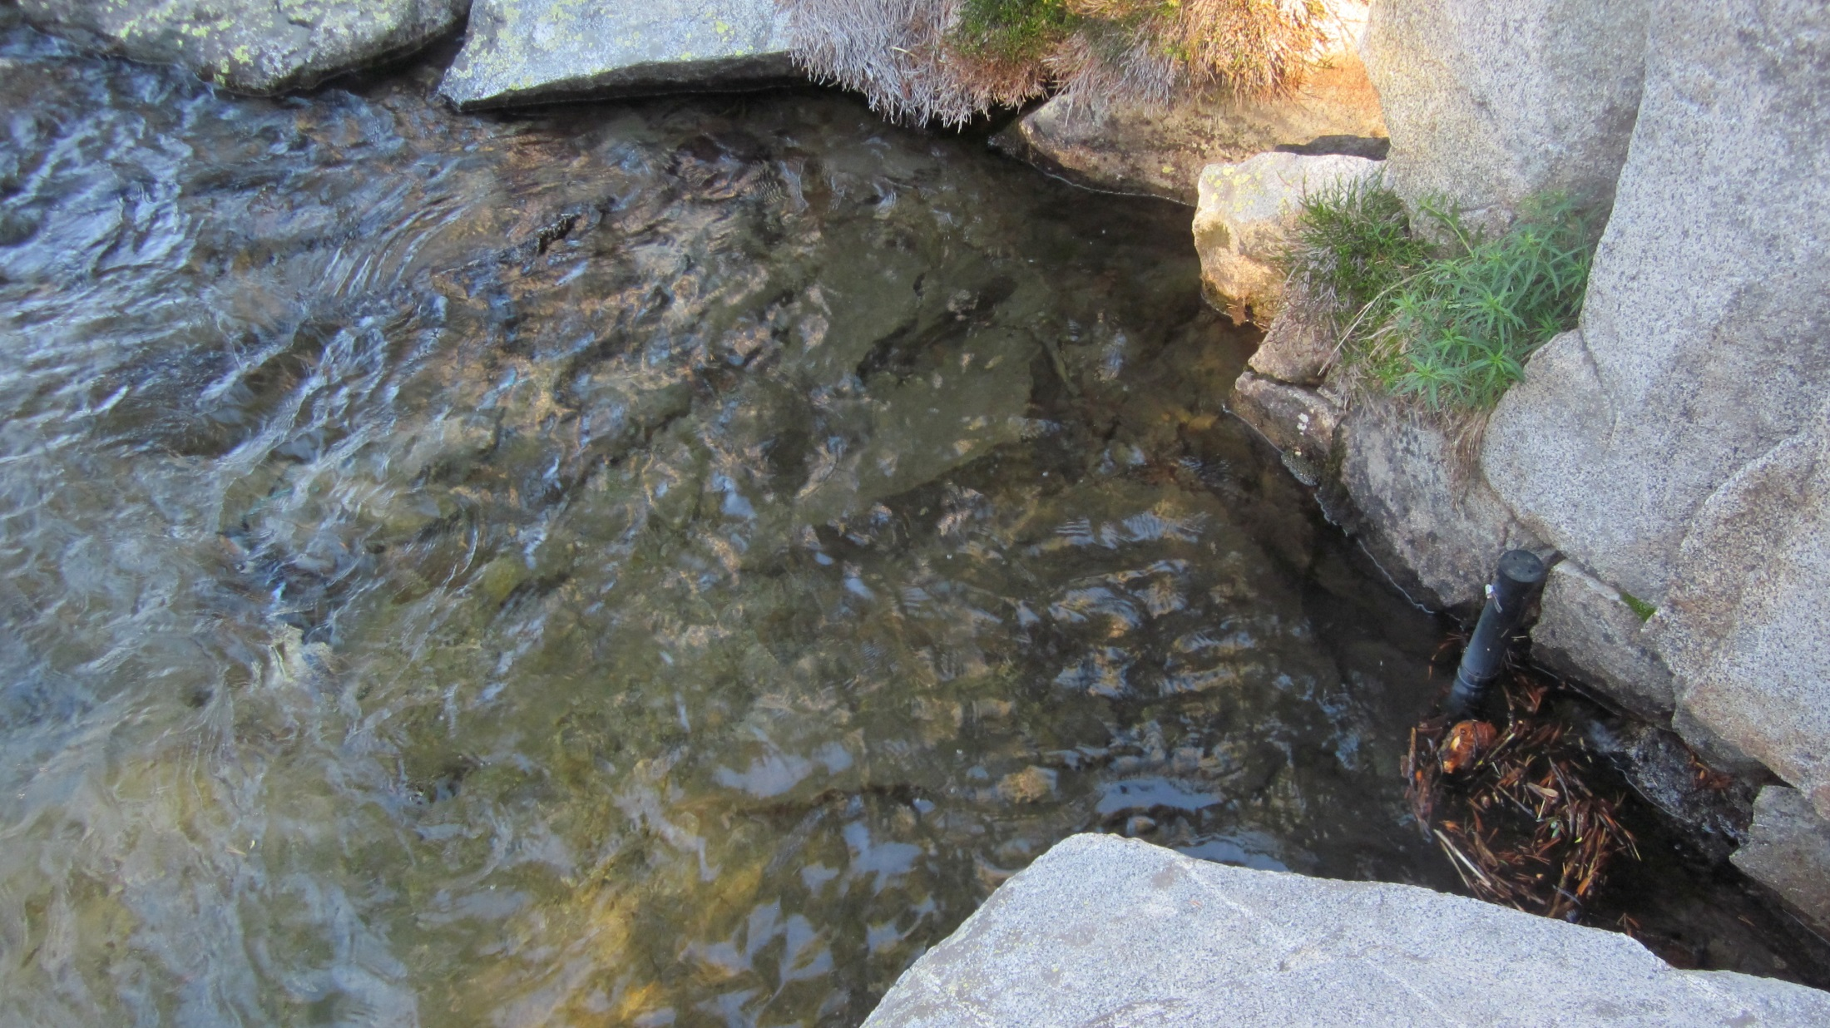
Old vented P.T. mount (removed 6/23/2015)
Photo: 7/24/2012
Solinst stilling
tube

Slide 14
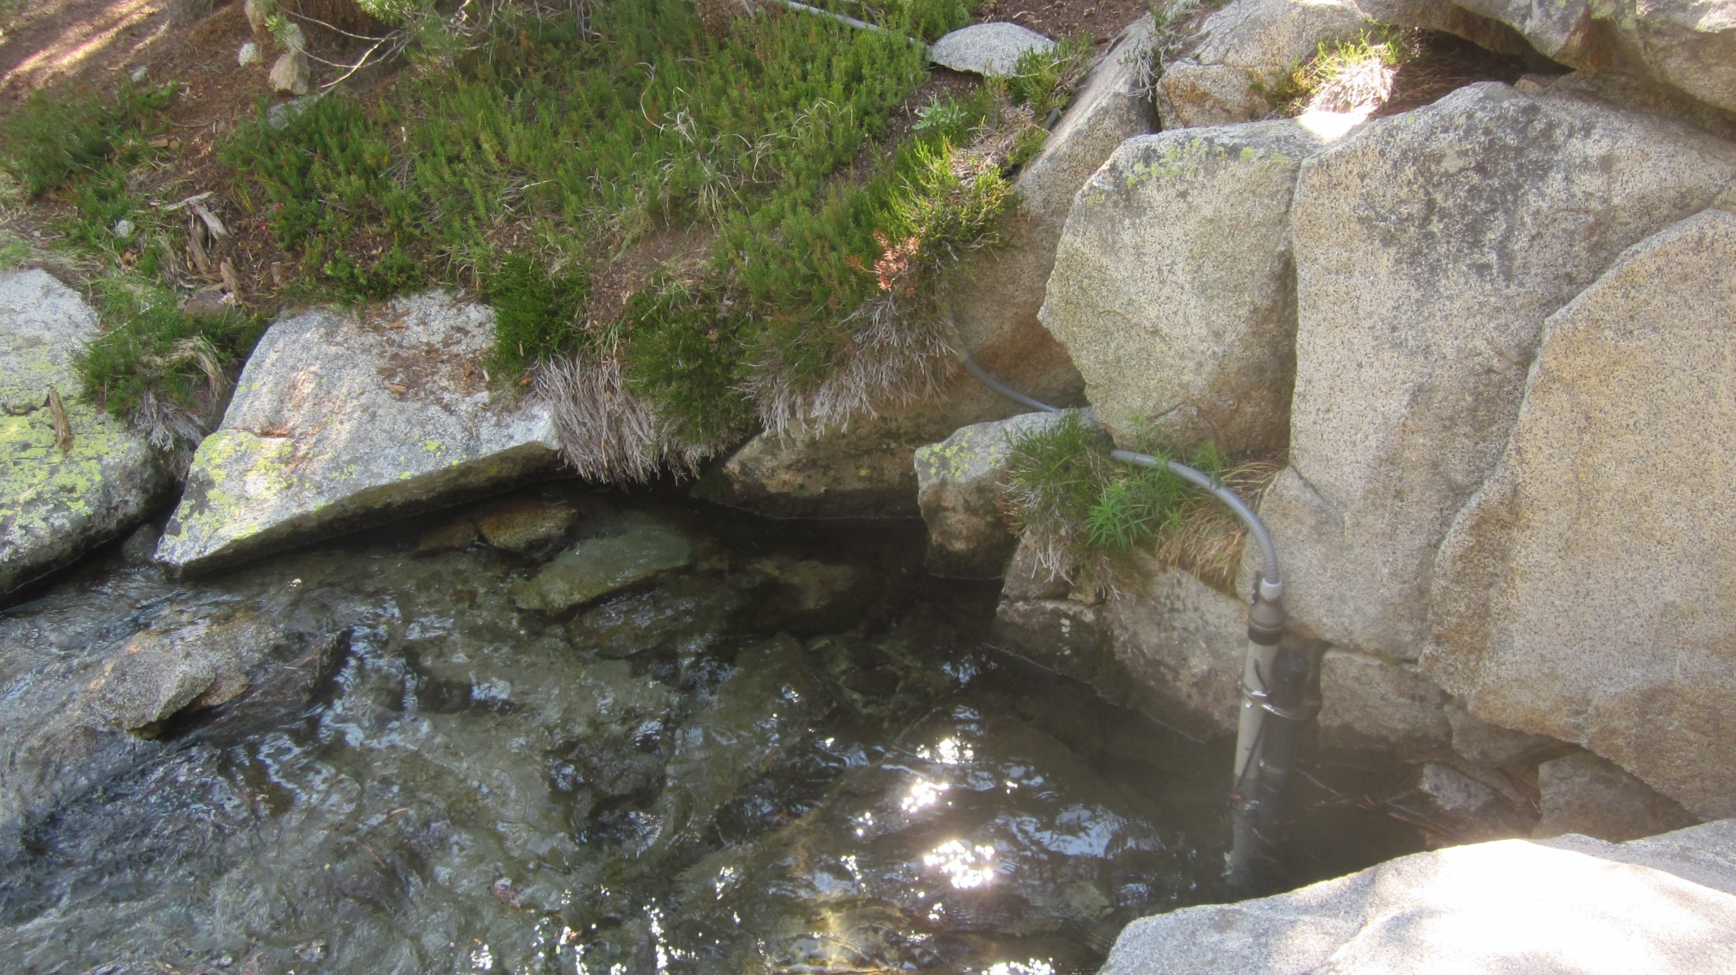
New Tape
Down datum
Photo: 6/23/2015
Solinst stilling
tube
New Vented P.T.
“Alpine Gage”

Slide 15
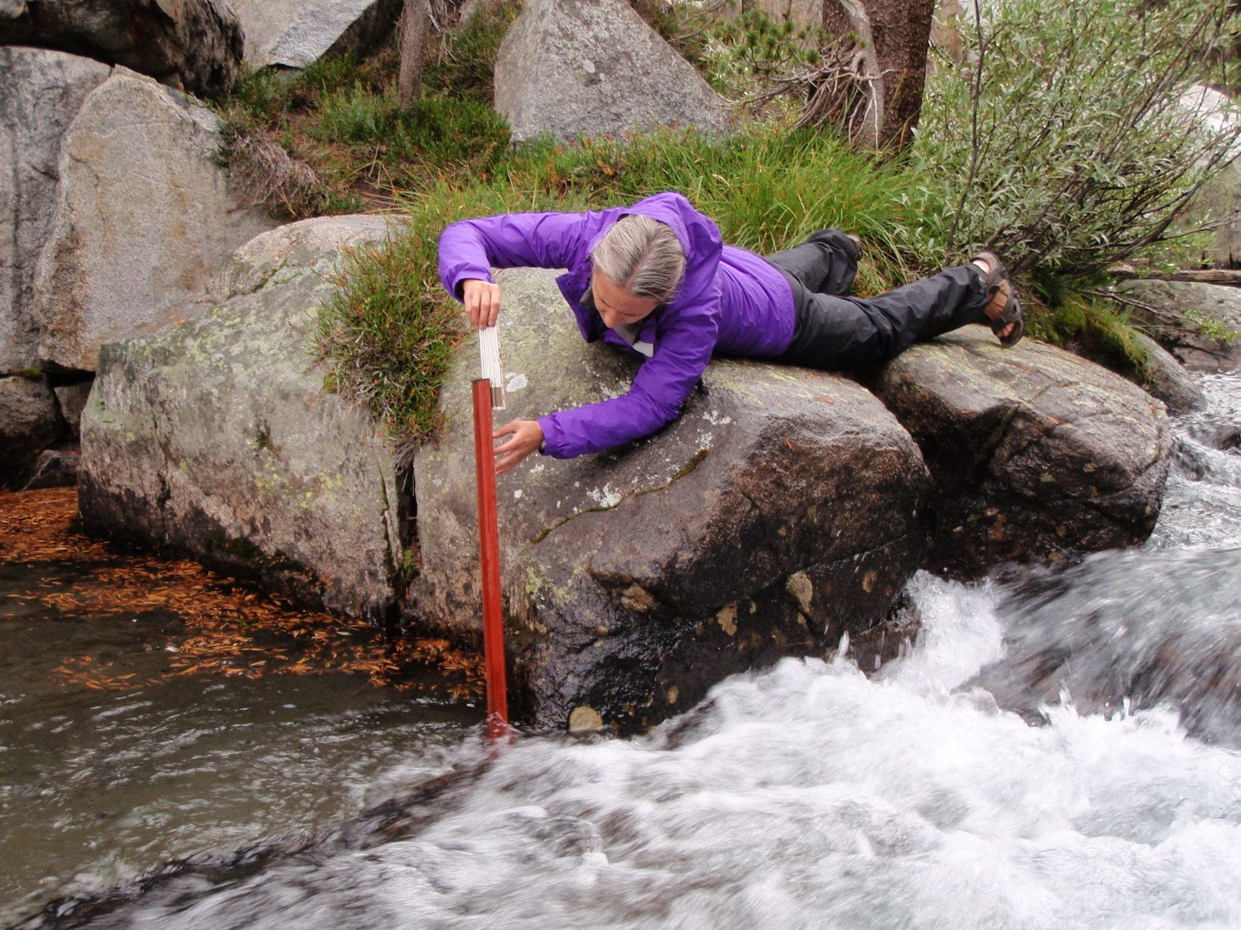
Tape down to water surface measurement on old
T-post, removed 6/23/2015.
Photo: 8/21/2013
Photo: 7/24/2012

Slide 16
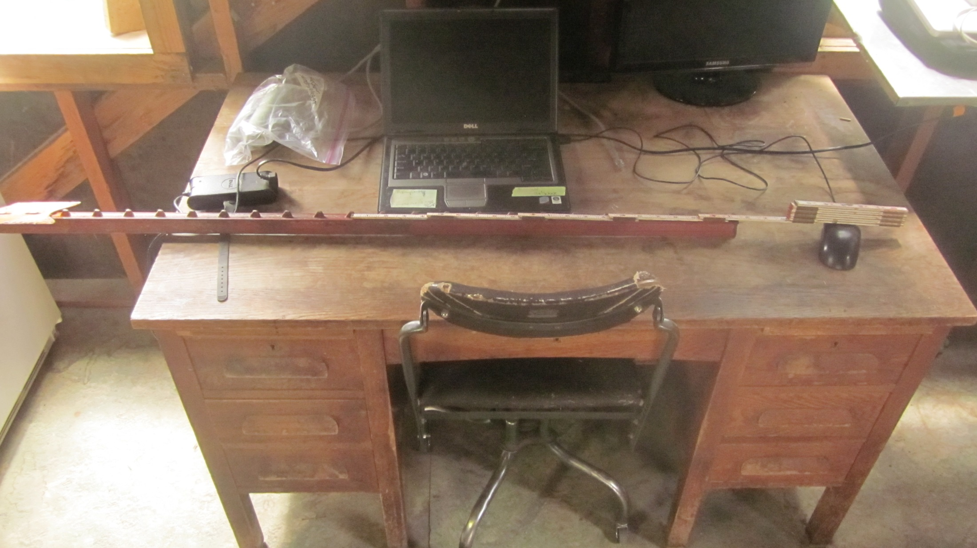
Photo: 7/02/2015
Old T-post, removed 6/23/2015

Slide 17
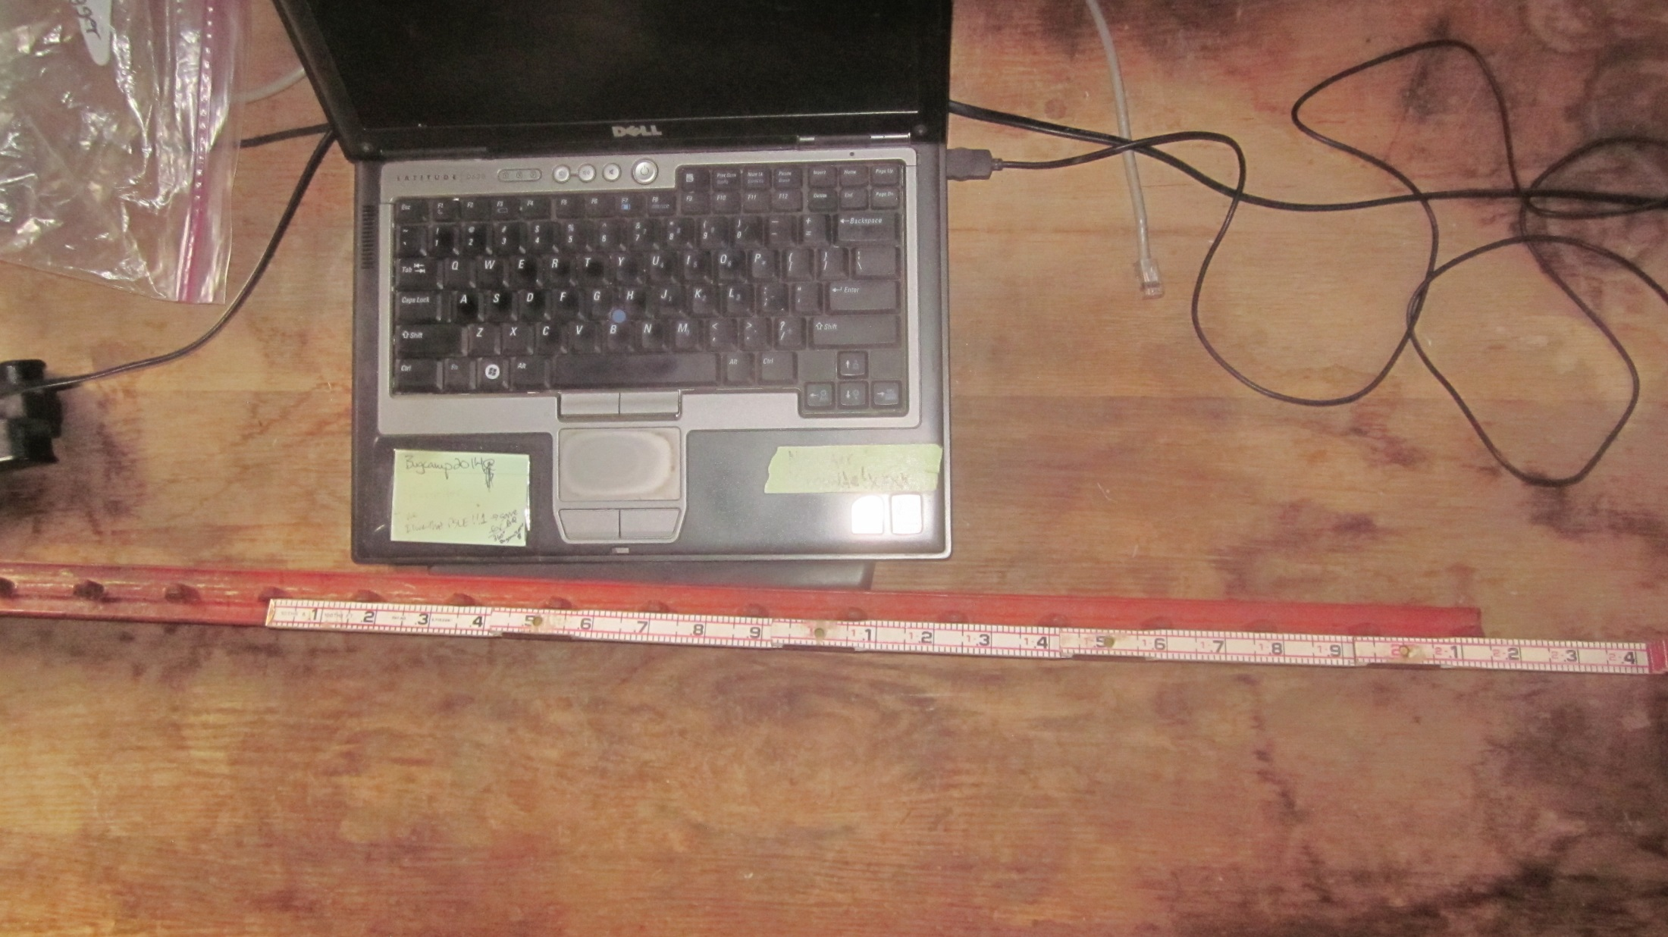
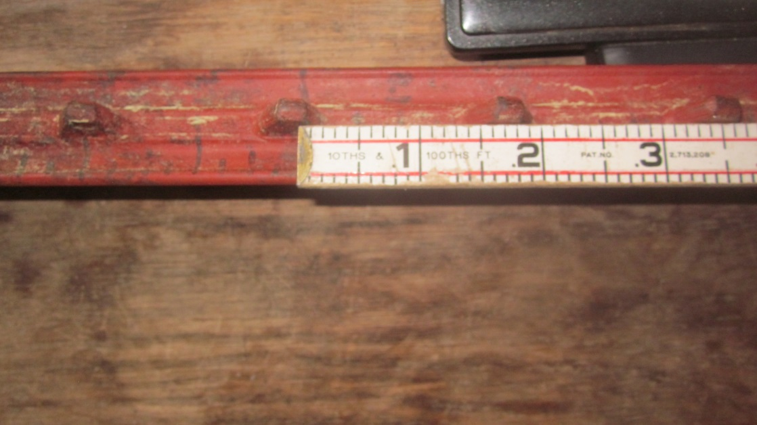
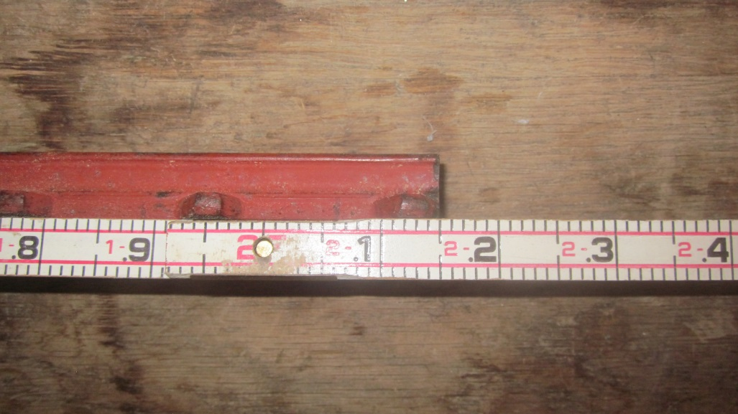
Photo: 7/02/2015
8 ft. sharpie mark-line
Distance “top” T-post to 8 ft. sharpie mark-line = 2.15 ft.
8 ft. “sharpie-staff-plate reading” = 7.85 ft. “ 10 – (T.D. to water surface) reading”
Vertical offset = 0.15 ft.

